Slide 1
Software Quality Assurance
By JoSepH Robson

Slide 2
What is Software Quality?
Software Quality is the degree of conformance to explicit or implicit requirements and expectations.
Software Quality is commonly assessed on two levels.
Functional Quality
How well the software conforms with design and specification.
Structural Quality
This is the more a software's maintenance requirements. How well does the software perform as needed.
Notes:
DEF: Explicit and suggested requirements
Expectations are end users expectations

Slide 3
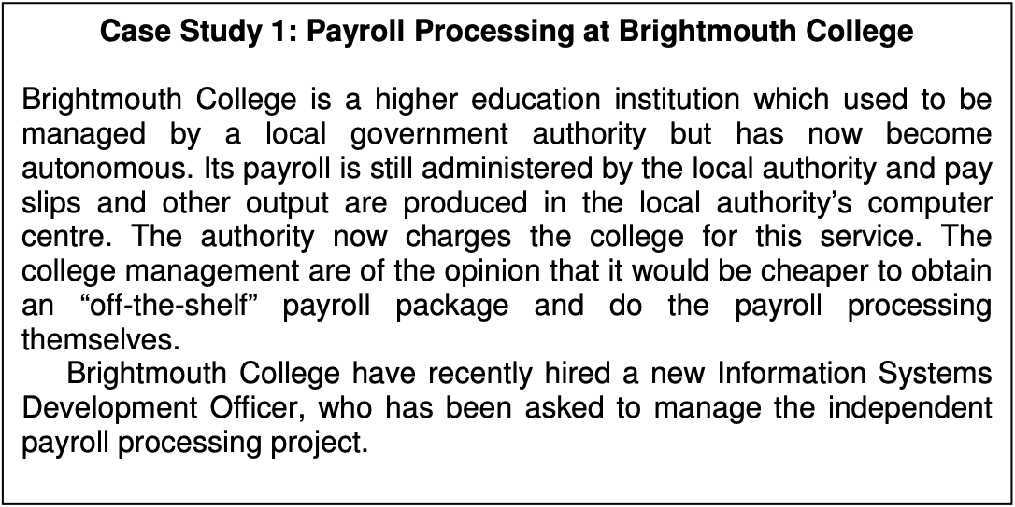
Case Study 1: Brightmouth College
Determining the quality of software for the new payroll package.
How well does the package meet explicit specification?
When in place how much maintenance would be required?
What features does the new package bring?

Slide 4


Can Software Quality Be Measured?
Measuring Software Quality can be difficult as it is not strictly defined. Quality is often seen as a mix of two definitions:
Software's compliance to its objective independent of its real world application.
The way we think and feel about the software in its real world application.
Kitchenham and Pfleeger and David Garvin give 5 different perspectives on quality that help us see what different people define as something of good quality.

Slide 5
Kitchenham, Pfleeger and Garvins 5 Perspectives
Transcendental Perspective
User Perspective
Manufacturing Perspective
Product Perspective
Value Based Perspective

Slide 6

Transcendental Perspective
The Transcendental Perspective is hard to define as it is more of a metaphysical feel of quality. Below are a few quotes that best describe the meaning of Transcendental Perspective.
”Something toward which we strive as an ideal, but may never implement completely".
B. Kitchenham and S. Pfleeger, "Software quality: the elusive target”, 1996.
"I know it when I see it”
S. H. Kan, "Metrics and Models in Software Quality Engineering”, 2002.

Slide 7

User Perspective
The user perspective is based around how fit for purpose a product is for use in the eyes of the user.
This perspective is all about how the product weights up against the users expectations.
This is a hard perspective to measure as users often have a vast expectation of the finished software’s capabilities.
The best way to go about this is to choose a few users and set out to meet their expectations.

Slide 8

Manufacturing Perspective
This perspective is about the quality of the manufacturing process as opposed to the overall product quality.
The manufacturing process is involved with setting up the main process of developing requirements, specifications throughout the company.
A lot of users don’t see the manufacturing process and so when reducing cost this is the first place to reduce funding.
Reducing funding in this area of production is very risky as this could lead to requirements not being fully assessed or specifications being flawed.

Slide 9

Product Perspective
This perspective says that quality can be measured by the characteristics of the product.
This is used during the development of a project, as by looking at the attributes associated with the different components of the product you can assess the projects quality.
This is a step back from the users perspective of the product and more an overview of how the product itself performs.

Slide 10

Value Based Perspective
This perspective is value based.
This meaning that decisions have importance or value to the stake holders therefore should be considered important.
This perspective ties in with the costs associated with each aspect of the products development.
If something is going to cost a lot with little evidence to support it making the money back, stakeholders will often lean towards reducing the risk.

Slide 11
Case Study 1: Brightmouth College
When the Systems development officer is making decision they will consider-
How well does each software package meet user requirements/ expectations.
How well regardless of the user does the software package get the job done
Is it more cost effective to choose an off the shelf one or to make one from scratch.

Slide 12
Any Questions?

